Slide 1

WEB SCRAPING TO GAIN COMPANY INSIGHTS
For purpose of Forage Internship

Slide 2
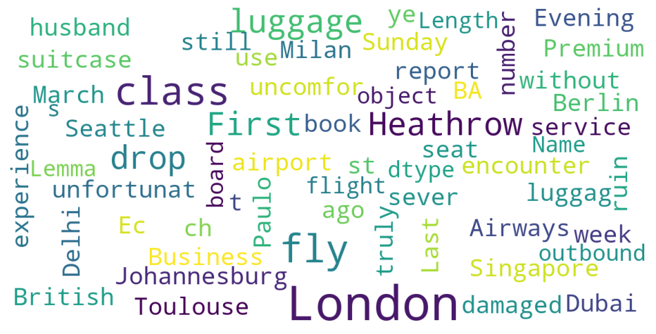
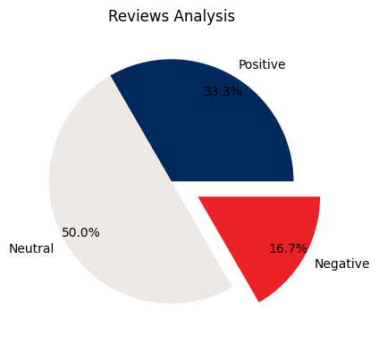
INSIGHTS FROM CUSTOMER REVIEWS FROM SKYLARK WEBSITE
For purpose of Forage Internship
From cleaning 1000 reviews given by the customers, we obtained
Positive Reviews – 469
Negative Reviews – 422
Neutral Reviews – 109
Word cloud of keywords used in reviews

